Slide 1
CS F301: Principles of Programing Languages

Slide 2
Procedure Activation: Introduction to Procedure, Recursion, Parameter passing methods

Slide 3
Introduction to Procedure
Procedures are constructs for giving a name to a piece of coding (body).
When the name is called , the body is executed.
Forms of procedures
Function Procedures (Functions)
Extend built-in operators of a language.
Return a single value.
Proper Procedures (Procedures)
Extends built in actions or statements.
Have a side effect such as setting variables or performing output and returns no value.
Source for slides 3-13: Ravi Sethi , "Programming Languages: Concepts and Constructs" 2nd Edition by Addison Wesley, 2006 (Reprint 2010).

Slide 4
Procedure Call
Use of a Procedure is referred to as a call of Procedure
< Procedure-name > ( < parameters> )
Functions are called from within expressions
example: r * sin( angle )
Procedures are treated as Atomic statements
example: read(ch) ;
Difference between function and procedure
Procedure cannot be called from a function, function can be called from a procedure.
Pascal have procedures and C, C++ use functions.

Slide 5
Elements of Procedure
Elements of procedure are,
A name for the declared Procedure
A body consisting of local declaration and statements
The formal parameters which are place holders for actuals
An optional result type
Example function square ( x : integer): integer
(pascal) begin
square := x * x
end ;
Example int square ( int x)
(C) {
int sq;
sq = x * x;
return sq;
}

Slide 6
Recursion: Multiple Activation
Each execution of a procedure body is referred to as an activation of the procedure.
A procedure is recursive if it can be activated from within its own procedure body.
Example: Factorial function
function f( n : integer) : integer;
begin
if n = 0 then f := 1 else
f := n * f ( n - 1 )
end ;
f(n) is computed in terms of f(n-1), f(n-1) in terms of f(n-2) and so on
for n = 3 the sequence of activation is a s follows
f(3) = 3 * f(2)
f(2) = 2 * f(1)
f(1) = 1 * f(0)
f(0) = 1
f(1) = 1
f(2) = 2
f(3) = 6

Slide 7
Benefits of Procedures
Procedure Abstractions.
Procedure name abstracts the implementation details.
Make the programs more readable and maintainable
Implementation Hiding
Allows the procedure implementation to be changed
Rest of program is not affected.
Modular Programs
Allow isolation of parts of programs for easy understanding.
Libraries
Math libraries. Sqrt(), string libraries, strcpy(),

Slide 8
Parameter Passing Methods
If communication is desired between the caller and the callee, arrangements must be made for passing values back and forth through the procedures parameters.
Parameter passing refers to the matching of actuals with formals when a Procedure call occurs.
Different interpretations of what a parameter stands for leads to different parameter passing methods. The Parameter passing methods are,
Call by values
Call by reference

Slide 9
Call by value
Gets Own Memory location
Gets initial value from corresponding actual position
Uses but does not change the actual parameter
Actual parameters can be variables or expressions of a return type
Example:
SI = Interest(PA,R,NY);
float Interest(int PA, float R, int NY)
{
float SI=PA*R*NY/100.0;
return SI;
}

Slide 10
Call by reference
Changes the value of the actual Parameter
Shares the memory location of the actual Parameter
Must match in type
The Actual Reference Parameter must have Location
Example:
procedure swap(var x : integer; var y : integer );
var z : integer;
begin
z := x; x := y; y := z;
end
A Call swap(i, A[i]) does the following,
make the location of x the same as that of i;
make the location of y the same as that of A[i];
if i=2 and A[i] = 99
z := 2; i := 99; A[2] := z
Thus these assignments exchange values in i and A[i]

Slide 11
In C language
The language C supports only the call by value as parameter passing.
Instead, C provides pointers so that we can simulate call by reference by passing pointers to functions as their parameters.
Example:
void swap (int * px, int * py) {
int z;
z = *px; *px = *py; *py = z;
}
The following program fragment swaps the values of variables a and b.
int a = 1, b = 2;
swap (&a, &b);

Slide 12
Procedure Activation: Scope rules for names, Nested scope

Slide 13
Introduction
Scope of a variable x: is the region of the program in which uses of x refers to its declaration.
Scope rules define the visibility rules for names in a programming language.
What if you have references to a variable named x in different parts of the program? Do these refer to the same variable or to different ones?
Static scope (lexical scope). Example Language: C, Pascal, Java
Dynamic Scope : Example Language: LISP, PYTHON
Static scoping also makes it much easier to make a modular code as programmer can figure out the scope just by looking at the code.
In contrast, dynamic scope requires the programmer to anticipate all possible dynamic contexts.

Slide 14
Scope rules for name
Names in programming language denote procedures, types, constants, and variables.
Binding requires between each use of a name and declaration.
The scope rules of a language determine the correspondence between an occurrence of a name (such as variables, types, procedures, etc.) and its declaration.
Two types of scope rules
In static scope (also called as lexical scope), scopes of names can be determined statically (i.e., in compile-time).
In dynamic scope, the binding of name occurrences to declarations is done dynamically (i.e., at run time).
Name occurrence
Scope rule
Declaration
Source for slides 3-14: Ravi Sethi , "Programming Languages: Concepts and Constructs" 2nd Edition by Addison Wesley, 2006 (Reprint 2010).

Slide 15
Static Scope (Lexical Scope)
A block defines a new scope. Variables can be declared in that scope, and are not visible from the outside. However, variables outside the scope – (in enclosing scopes) are visible unless they are overridden.
A variable always refers to its top level environment.
Binding of a variable can be determined by program text and is independent of the run-time function call stack.
The compiler first searches in the current block, then in global variables, then in successively smaller scopes.

Slide 16
Dynamic Scope
Dynamic scoping does not care how the code is written, but instead how it executes. Each time a new function is executed, a new scope is pushed onto the stack.
With dynamic scope, a global identifier refers to the identifier associated with the most recent environment.
The occurrence of a identifier is searched in the most recent binding.
The compiler first searches the current block and then successively all the calling functions.
Perl supports both dynamic and static scoping. Perl’s keyword “my” defines a statically scoped local variable, while the keyword “local” defines dynamically scoped local variable.

Slide 17
Example for Static and Dynamic Scope
// A C program to demonstrate static scoping.
#include<stdio.h>
int x = 10;
// Called by g()
int f()
{ return x; }
// g() has its own variable
// named as x and calls f()
int g()
{
int x = 20; return f();
}
int main()
{
printf("%d", g()); printf("\n");
return 0;
}
Output:
10
//Dynamic Scope
int x = 10;
// Called by g()
int f()
{
return x;
}
// g() has its own variable
// named as x and calls f()
int g()
{
int x = 20; return f();
}
main()
{
printf(g());
}
Output:
20
Source: https://www.geeksforgeeks.org/static-and-dynamic-scoping/

Slide 18
Macro expansion and dynamic scope
If a procedure body is simply copied or substituted at the point of call, we get dynamic scope. A macro processor does:
Actual parameters are textually substituted for the formals.
The resulting procedure body is textually substituted for the call.
Textual substitution in C
Example: #define MAXBUF 4
Every occurrence of MAXBUF is replaced by 4 before the program is compiled.

Slide 19
Parameter passing (Textual Substitution)
Macro expansion uses textual substitution for parameter passing.
Example:
In case of swap(i,A[i]) does not simply exchange the values of i and A[i] under macro expansion. Textual substitution of the actuals into the procedure body yields
z := i, i := A[i]; A[i] =z
If i is initially 2 and A[2] is initially 99, this sequence is equivalent to, swap(i, A[i]) →
z := 2, i := 99; A[i] =2 output is : i= 99 and A[99]= 2
The final assignment uses the modified value of i.
(compare this with Call by Reference: slide 10:
There when we did swap(i, A[i]), i.e. swap(2, 99), we got output as i = 99 and A[2]= 2)

Slide 20
Nested scopes: Variable declarations in C
Variable declarations can appear within any grouping of statements in C.
Compound statements are grouped within braces { and }
{ < declaration-list> <statement-list>}
Example:
{
int I=0;
while (I <= limit)
{ …..
I++;
}
}

Slide 21
Nested compound statements
int main(…) {
int main(…) {
int i;
for(…)
{
int c;
if(…)
{
int i;
…
}
…
}
while(…)
{
int i;
….
}
…}
int i₁;
for(…)
{
int c;
if(…)
{
int i₂;
…
}
…
}
while(…)
{
int i₃;
….
}
…}
(a) Nested compound statement
(b) Scope of i1

Slide 22
Nested Scope: Procedure declaration
Program mymain1()
Program mymain2()
procedure A;
procedure C;
procedure A1;
procedure C1;
procedure A2;
procedure C2;
procedure B;

Slide 23
Procedure Activation: Run-Time Environment, Activation Record, Tail Recursion Elimination

Slide 24
Runtime Environments
Why understand runtime environments?
Goal is to study/design prog lang features related to
Procedures : defined and accesses
Same variable appears in different parts of the program.
Parameter passing to procedures and accessed in procedures
How Recursion works
Procedure Activations : What happens during procedure is executed.
int x = 10; y;
int func (int a, int *b) { int x; x = a + *b; return x; }
main() { int y = 10; int x = func (3, &y);
Global & Local data : How are they stored and access.
Code : x = a + *b
Dynamic memory allocation : Heaps

Slide 25
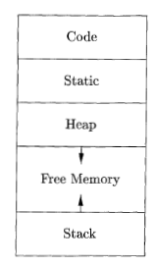
Run Time Mem Models
Layout of executable file
int a[10], b, c;
main()
{
int x , y, *xp;
x = x + y;
xp = malloc(..);
}
Code: machine code of the program
Static : data that is live through out program execution
Heap : dynamic memory (data) eg , malloc()
Stack: Data (activation record) allocated during procedure calls
Notes:
25

Slide 26
Run Time Mem Models
Layout of executable file
int a[10], b, c;
main()
{
int x , y, *xp;
xp = malloc(..);
}
Stack Storage : local variables of a proc are allocated in stack
Heap Storage: dynamic mem allocation (malloc, new) etc
Notes:
26

Slide 27
Stack Allocation of Space
How stack allocation happens when procedures/functions are called (activated, executed)
Space for local variables are allocated on stack
Reclaimed when the procedure terminates
Allows sharing of spaces between procedures that don’t nest in time
Relative addr of variable are same..
Pascal and C held activation records on stack
Activation Trees : procedure activations of a program can be represented in the form of a tree.
Notes:
27

Slide 28
Heap allocation and deallocation
Heap is a storage spot for activation records.
.Dynamic Memory is allocated using Heap.
Garbage collection - technique to reclaim storage that is no longer needed. (you will study later in Compilers Course: Reference Counting, Mark and Sweep Algorithm etc)
Lifetimes of activation records need not be tied to the last-in/first-out flow of control between activations. The activation records stay here as long as they are needed

Slide 29
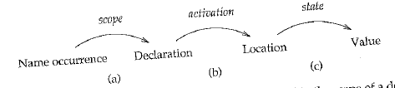
Procedure Activations
From Name to declaration : Scope rules for names : name x can be used to store different data type in the same program. Binding of name occurrences to declarations is defined in terms of lexical context.
From declarations to storage location: When procedure executed or activated , variable get bound to (memory) locations. Binding of declarations to locations is done at activation time. Important for Recursive Procedures.
From location to value: What does the occurrence of variable x refer to (its value or location). The binding of locations to values is done dynamically at run time and can be changed by assignments.

Slide 31
The global and/or static data of a program can be fixed in memory prior to execution
Data are allocated separately in a fixed area in a similar fashion to the code
In Fortran77, all data are in this class;
In Pascal, global variables are in this class;
In C, the external and static variables are in this class
The constants are usually allocated memory in the global/static area
Const declarations of C and Pascal;
Literal values used in the code,
such as “Hello%D\n” and Integer value 12345:
Printf(“Hello %d\n”,12345);

Slide 34
Processor Registers
part of the structure of the runtime environment
Registers may be used to store temporaries, local variables, or even global variables;
Special-purpose registers to keep track of execution
PC program counter: hold the address of the next instruction to be executed.
SP stack pointer; a point to the last location allocated on the call stack
FP frame pointer; a pointer to the current activation record to allow access to local variable;
AP argument pointer: points to the current argument (parameter).

Slide 35

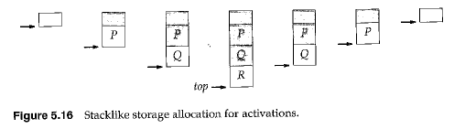
Stack Allocation & Deallocation
Layout of executable file
P()
{
Q();
R();
}
main()
{
P()
}
Notes:
35

Slide 36
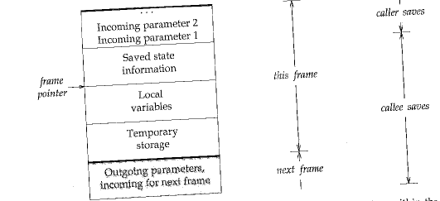
Layout of activation record
Notes:
36

Slide 37
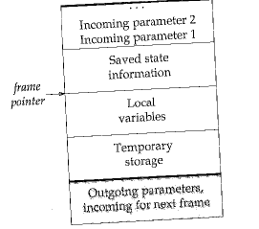
Activation Record & Func Parameters
How variables are referenced.
Recursive functions
Functions as parameters
Variable no of arguments
Static variables
func(int a, int b)
{
int x, y, z;
z = func(x, y);
}
main()
{
int y; y=func(2, 3);
}

Slide 38
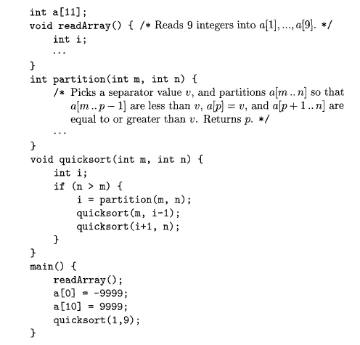
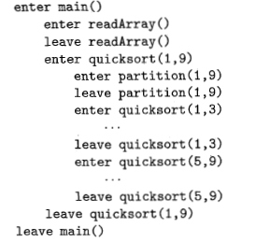
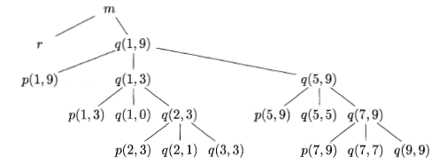
Stack Allocation: Activation Trees
Notes:
38

Slide 39
Allocating static variables at compile time
Static variables retains their values between activations.
Local variables are bound to distinct storage in each activations.
Storage is allocated at compile time.
Languages without recursive procedure treat all variables as static.
Lifetime of static variable is the entire computation, which retains value from activation to activation.
Static variable declaration is C
Example: static int count = 0;

Slide 40
Lexical Scope: Procedures as in C
C use stack to organize storage for local variables.
With last-in/first-out flow, necessary to use following principal
Principle: Storage for a variable declared within a procedure is local to a procedure activation. (Lifetime of local)
Storage allocated when activation is set and deallocated when activations ends.
Activation records on stack called as stack frame.
C does not allows procedure bodies to be nested, so uses control links only.
There are two places two look for declaration of procedure P
Within the same procedure
Outside all procedures

Slide 41
Storage for local variables in C
Variables declared within a block are local to an execution of the block.
Example: { int c;…}
Stack frame for each block, frame is allocated upon entry and deallocated upon block entry.
C treats procedure activations as the unit for storage allocation.
Variables in disjoint blocks within a procedure can share storage because they are not needed simultaneously.
Example: { int c;
{ int i; …
}
….
{ int j; …
}
}

Slide 42
Variable access at run time
Layout of activation is known at run time.
Frame is put on the stack and storage within is accessed relative to the frame pointer.
The values of variables in an activation, accessed as,
frame pointer + displacement (or offset)
Displacement is calculated at run time.

Slide 43
Recursion vs Tail Recursion
In traditional recursion, the typical model is that you perform your recursive calls first, and then you take the return value of the recursive call and calculate the result. In this manner, you don't get the result of your calculation until you have returned from every recursive call.
In tail recursion, you perform your calculations first, and then you execute the recursive call, passing the results of your current step to the next recursive step.
Once you are ready to perform your next recursive step, you don't need the current stack frame any more. Reuse the current stack frame for the next recursive step.

Slide 44
A function call is said to be tail recursive if there is nothing to do after the function returns except return its value.
A compiler replaces the caller in place with the callee, so that instead of nesting the stack deeper, the current stack frame is reused.
Consider this recursive definition of the factorial function in C:
factorial(n) {
if (n == 0) return 1;
return n * factorial(n - 1);
}
---------------------------------------------------------
Tail Recursive form is below:
factorial1(n, accumulator) {
if (n == 0) return accumulator;
return factorial1(n - 1, n * accumulator);
}
factorial(n) {
return factorial1(n, 1);
}

Slide 45
Tail-recursion elimination
If the last statement executed in the body of a procedure P is a recursive call, the call is said to be tail recursive.
Procedure is tail recursive if all its recursive calls are tail recursive.
Tail recursive call can be eliminated and replaced by control flow within procedure.
Example:
void print(int n)
{ start:
if (n < 0)
return;
cout << " " << n;
// Update parameters of recursive call
// and replace recursive call with goto
n = n-1
goto start;
}
void print(int n)
{
if (n < 0)
return;
cout << " " << n;
// The last executed statement is recursive call
print(n-1);
}
(a) Before tail-recursion
(b) After tail-recursion elimination
Source: https://www.geeksforgeeks.org/tail-call-elimination/

Slide 46
Tail-recursion elimination (cont..)
Example
void quickSort(int arr[], int low, int high)
{
start:
if (low < high)
{
/* pi is partitioning index, arr[p] is now at
right place */
int pi = partition(arr, low, high);
// Separately sort elements before
// partition and after partition
quickSort(arr, low, pi - 1);
// Update parameters of recursive call
// and replace recursive call with goto
low = pi+1;
high = high;
goto start;
}
}
void quickSort(int arr[], int low, int high)
{
if (low < high)
{
/* pi is partitioning index, arr[p] is now at right place */
int pi = partition(arr, low, high);
// Separately sort elements before
// partition and after partition
quickSort(arr, low, pi - 1);
quickSort(arr, pi + 1, high);
}
}
(a) Before tail-recursion
(b) After tail-recursion elimination
Source: https://www.geeksforgeeks.org/tail-call-elimination/

Slide 47
P()
{
Q()
{
R();
}
}
T(){}
Main()
{
T();
P();
}
m
T
P
Q
R

Slide 48
Thank you

